Slide 1
DBMS
Introduction

Slide 2
File Systems
File Terminology
Data
  Raw Facts
Field
  Group of characters with specific meaning
Record
  Logically connected fields that describe an object: person, place, thing or activity
File
  Collection of related records

Slide 3
Database
A database is a structure that can store information about multiple types of entities, the attribute of the entities and the relationship among data.
An entity is a person, place, object, event or idea for which one wants to store and process further
An attribute is property of an entity.
A relationship is an association between entities.

Slide 4
Database Management System (DBMS)
DBMS contains information about a particular enterprise
Collection of interrelated data
Set of programs to access the data
An environment that is both convenient and efficient to use
Database Applications:
Banking: all transactions
Airlines: reservations, schedules
Universities: registration, grades
Sales: customers, products, purchases

Slide 5
DBMS
A “database management system” is “a general purpose software system that facilitates the processes of
  constructing and
  manipulating databases for various applications, where these applications represent some activities of interest done in the DB owner’s real life, or “Universe of Discourse”
  defining
DBMS + data records = a “database system”
DBMS main contribution is construction & maintenance of meta-data

Slide 6
Purpose of Database Systems
In the early days, database applications were built directly on top of file systems
Drawbacks of using file systems to store data:
Data redundancy and inconsistency
Multiple file formats, duplication of information in different files
Difficulty in accessing data
Need to write a new program to carry out each new task
Data isolation —multiple files and formats
Integrity problems
Integrity constraints (e.g. account balance > 0) become “buried”in program code rather than being stated explicitly
Hard to add new constraints or change existing ones

Slide 7
Purpose of Database Systems (contd..)
Atomicity of updates
Failures may leave database in an inconsistent state with partial updates carried out
Example: Transfer of funds from one account to another should either complete or not happen at all
Concurrent access by multiple users
Concurrent accessed needed for performance
Uncontrolled concurrent accesses can lead to inconsistencies
Example: Two people reading a balance and updating it at the same time
Security problems
Hard to provide user access to some, but not all, data
Database systems offer solutions to all the above problems

Slide 8
Disadvantages of Database Processing
Larger cost / File size- to support all the complex functions that it provides to users, needs more space and memory in turns overhead charges
Increased Complexity- in order to take full advantage of DBMS, users must understand features of system
Greater Impact of failure- failure of any single file may affect all the other user.
More difficult recovery- more complexity- more difficult recovery if fails.

Slide 9
Levels of Abstraction
Physical level: describes how a record (e.g., customer) is stored.
Logical level: describes data stored in database, and the relationships among the data.
typecustomer= record
customer_id: string;
customer_name: string;
customer_street: string;
customer_city: integer;
  end;
View level: Application programs hide details of data types. Views can also hide information (such as an employee’s salary) for security purposes.

Slide 10
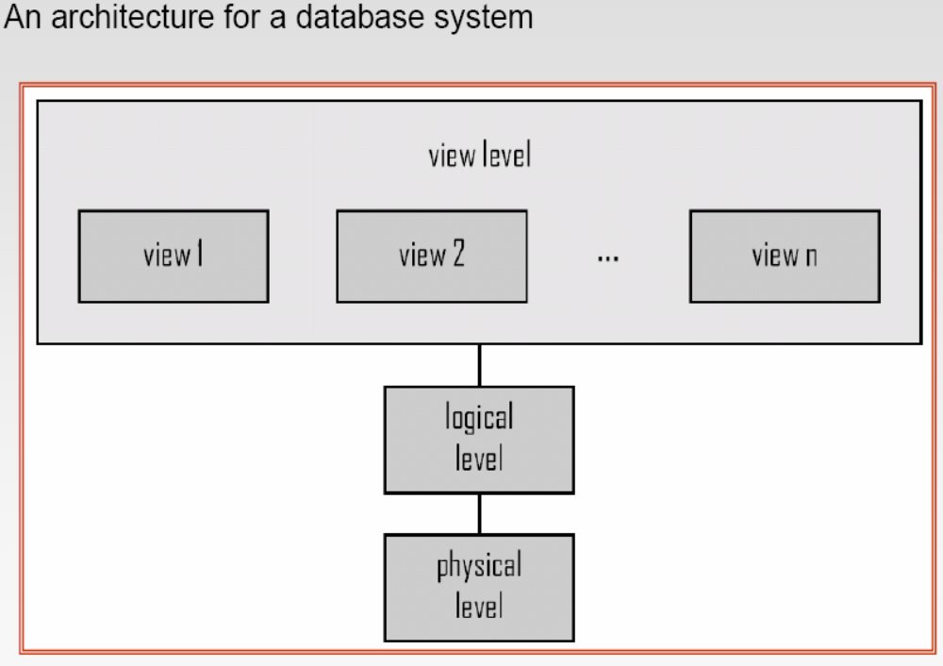

Slide 11
Instances and Schemas
Schema–the logical structure of the database
Example: The database consists of information about a set of customers and accounts and the relationship between them)
Analogous to type information of a variable in a program
Physical schema: database design at the physical level
Logical schema: database design at the logical level
Instance–the actual content of the database at a particular point in time
Analogous to the value of a variable

Slide 12
Data Independence
Physical Data Independence–the ability to modify the physical schema without changing the Applications ( depend on the logical schema )
Logical Data Independence–the ability to modify the logical schema without changing the application program.
In general, the interfaces between the various levels and components should be well defined so that changes in some parts do not seriously influence others

Slide 13
File Systems
Data file 1
Application 1
Data file 2
Data file 3
Application 2
Data file 4
Application 3
Data file 5

Slide 14
File Systems
File System Data Management
  Requires extensive programming in third-generation language (3GL)
  Time consuming
Data Dependence
  Change in file’s data characteristics requires modification of data access programs
  Must express program what to do and how
  file systems are cumbersome from programming and data management views

Slide 15
File Systems
Structural Dependence
  Change in file structure requires modification of related programs
Field Definitions and Naming Conventions
  Flexible record definition anticipates reporting requirements
  Selection of proper field names important
  Attention to length of field names
  Use of unique record identifiers
Data Redundancy
  Different and conflicting versions of same data
  Results of uncontrolled data redundancy, that could lead to inconsistency and loss of data integrity

Slide 16
Database Systems
Database
Management System
Data file 1
Data file 1
Application 1
Data file 2
Data file 2
Data file 3
Data file 3
Application 2
Data file 4
Data file 4
Application 3
Data file 5
Data file 5

Slide 17
Data file 1
Application 1
Data file 2
File System ( 2tier )
Data file 3
Application 2
Data file 4
Application 3
Data file 5
Database
Management System
Application 1
Data file 1
Data file 1
Data file 2
Data file 2
Databases (3 tier)
Data file 3
Data file 3
Application 2
Data file 4
Data file 4
Application 3
Data file 5
Data file 5

Slide 18
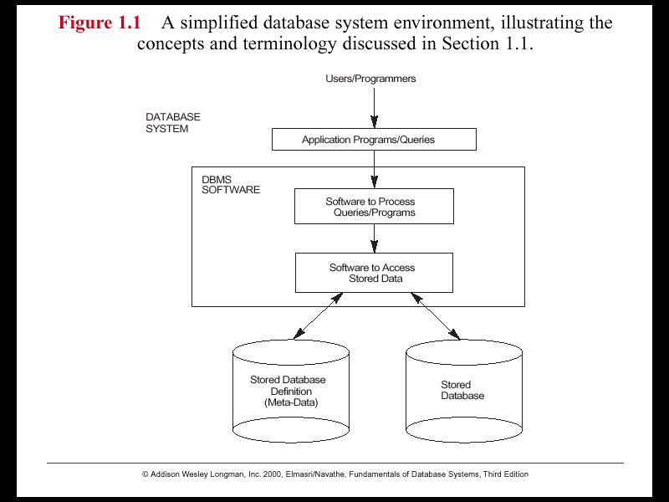

Slide 19
Data Models
A collection of tools for describing Data
  Data relationships
  Data semantics
  Data constraints
Different Models:
Relational model
Entity-Relationship data model (mainly for database design)
Object-based data models (Object-oriented and Object-relational)
Semi structured data model (XML)
Other older models:
Network model
Hierarchical model

Slide 20
What and Where is the “meta-data”?
Identities of data elements
Data element lengths (sets max/min values)
Data types (restriction on value ranges)
Where each element can be found logically
  COLUMN within a TABLE
  TABLE within a DATABASE
  INDEX for a TABLE
  VIEW of a TABLE or TABLES
  CONSTRAINT for a COLUMN or TABLE
  GRANT permissions on COLUMNS, TABLES, VIEWS

Slide 21
Defining, constructing and manipulating a database
Build & modify structure: CREATE, ALTER, DROP...
Store records: INSERT, DELETE, UPDATE, Retrieve records: SELECT, REPORT WRITER etc.
Apply rules to derive more information:
  Embedded SQL, FUNCTION procedures
Apply rules to implement policy:
  VIEWS, GRANT , REVOKE, CONSTRAINT

Slide 22
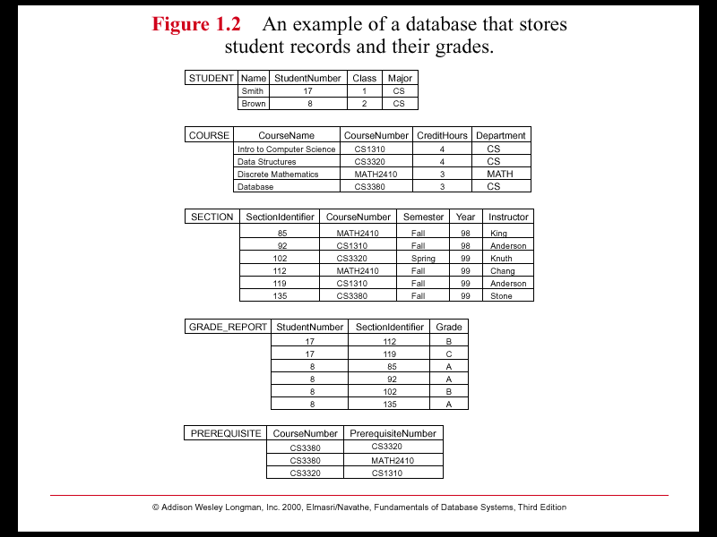

Slide 23
Types of users and their roles
Registering facts or events:
the user
Defining new organisational initiatives:
the DB Designer
Building these requirements into the DB:
the DB Administrator
Creating intelligent interfaces:
Software engineers
Registering changes in policy:
the DB Administrator

Slide 24
DBMS – functionalities and services
Data storage, retrieval and modification
A user accessible catalog
Support for transactions
Concurrency control services
Recovery services
Security services
Integrity services
Data communication support
Data independence
Utility services

Slide 25
Data Manipulation Language (DML)
Language for accessing and manipulating the data organized by the appropriate data model
DML also known as query language
Two classes of languages
Procedural –user specifies what data is required and how to get those data
Declarative (nonprocedural) –user specifies what data is required without specifying how to get those data
SQL is the most widely used query language

Slide 26
Data Definition Language (DDL)
Specification notation for defining the database schema
Example: create table account(
account-number char(10),
Balance integer)
DDL compiler generates a set of tables stored in a data dictionary
Data dictionary contains metadata (i.e., data about data)
Database schema
Data storage and definition language
Specifies the storage structure and access methods used
Integrity constraints
Domain constraints
Referential integrity (references constraint in SQL)
Assertions
Authorization

Slide 27
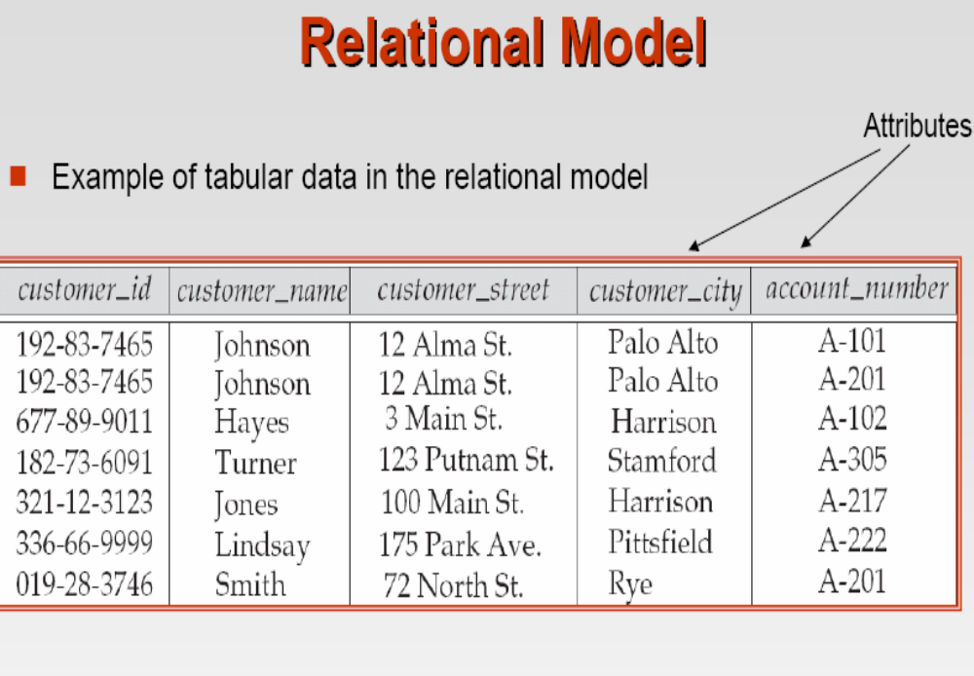

Slide 28
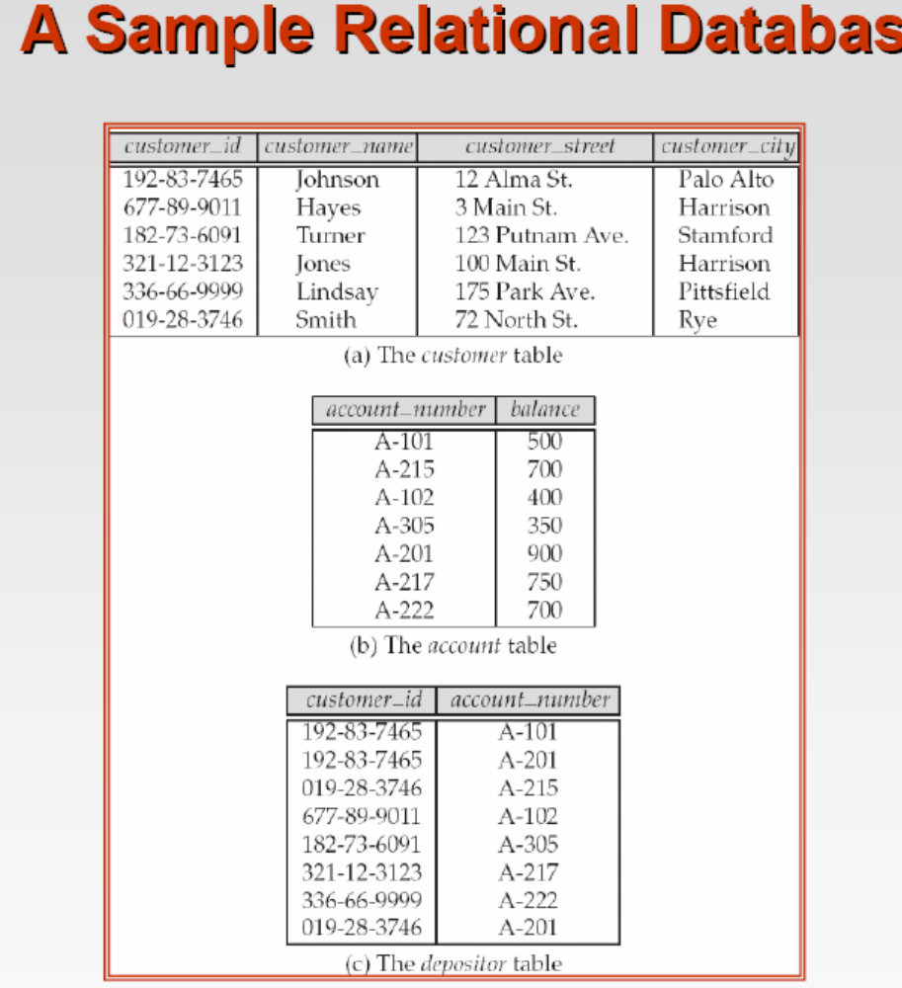

Slide 29
Database Design
The process of designing the general structure of the database:
Logical Design –Deciding on the database schema. Database design requires that we find a “good” collection of relation schemas
Business decision –What attributes should we record in the database?
Computer Science decision –What relation schemas should we have and how should the attributes be distributed among the various relation schemas?
Physical Design –Deciding on the physical layout of the database

Slide 30
Entity relationship Model
1976 proposed by Peter Chen
ER diagram is widely used in database design
  Represent conceptual level of a database system
  Describe things and their relationships in high level

Slide 31
Basic Concepts
Entity set – an abstraction of similar things, e.g. cars, students
  An entity set contains many entities
Attributes: common properties of the entities in a entity sets
Relationship – specify the relations among entities from two or more entity sets

Slide 32
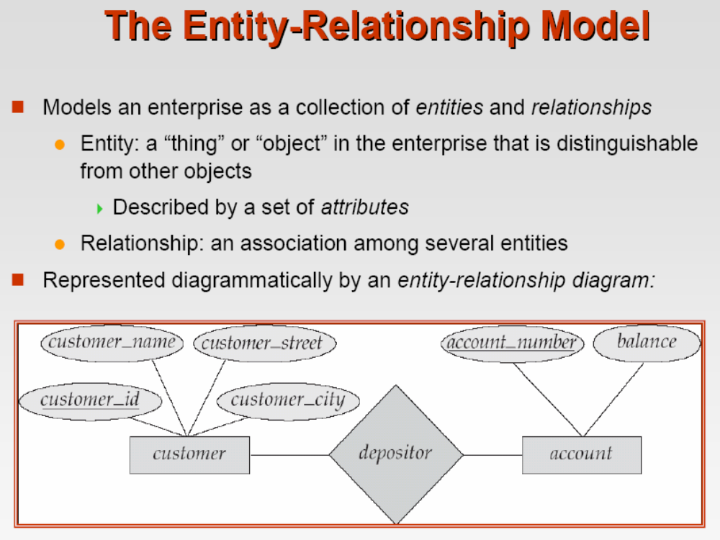

Slide 33

An Example

Slide 34
Relationship
A relationship may be thought as a set as well
  For binary relationship, it enumerates the pairs of entities that relate to each other
  For example, entity set M = {Mike, Jack, Tom} entity set F = {Mary, Kate}. The relationship set married between M and F may be {<Mike,Mary>,<Tom, Kate>}

Slide 35
Relationship
A relationship set is a mathematical relation among n ≥ 2 entities, each taken from entity sets
{(e₁, e₂, … e_{n}) | e₁ ∈ E₁, e₂ ∈ E₂, …, e_{n} ∈ E_{n}}
where (e₁, e₂, …, e_{n}) is a relationship
  Example:
  (Amaze, A-1, MNIT) ∈ depositor

Slide 36

Relationship Example

Slide 37
Relationship
The degree of a relationship = the number of entity sets that participate in the relationship
  Unary ( self relation ship )
  Mostly binary relationships
  Sometimes more
Mapping cardinality of a relationship
  1 –1 1 – many
  many – 1 Many-many

Slide 38

One-One and One-Many

Slide 39

Many-one and many-many

Slide 40

1- many

Slide 41
Many - 1

Slide 42
Many - many

Slide 43

Attribute of A Relationship Set

Slide 44

Alternative Cardinality Specification

Slide 45
Mapping Cardinality
Both many and 1 include 0
  Meaning some entity may not participate in the relationship

Slide 46

Total Participation
When we require all entities to participate in the relationship (total participation), we use double lines to specify
Every loan has to have at least one customer

Slide 47

Self Relationship
Sometimes entities in a entity set may relate to other entities in the same set. Thus self relationship
Here employees mange some other employees
The labels “manger” and “worker” are called roles the self relationship

Slide 48
More examples on self-relationship
People to people
  Parent – children
  Manager – employee
  Husband – wife ( spouse)

Slide 49
Attributes
Both entity sets and relationships can have attributes
Attributes may be
  Composite
  Multi-valued (double ellipse)
  Derive (dashed ellipse)

Slide 50

Notations ERD

Slide 51

Another Example

Slide 52
Keys
A super key of an entity set is a set of one or more attributes whose values uniquely determine each entity.
A candidate key of an entity set is a minimal super key
Although several candidate keys may exist, one of the candidate keys is selected to be the primary key.

Slide 53
Key Examples
Suggest super keys for the following entity?
What are the candidate keys?
Primary key?
author
name
Date of birth
description

Slide 54

Ternary Relationship

Slide 55
Decompose a Ternary Relationship
Some relationships that appear to be non-binary may be better represented using binary relationships
  E.g. A ternary relationship parents, relating a child to his/her father and mother, is best replaced by two binary relationships, father and mother
    Using two binary relationships allows partial information (e.g. only mother/ father being known)
  But there are some relationships that are naturally non-binary e.g. works-on

Slide 56

Converting Ternary to binary

Slide 57
Converting Ternary to binary
In general, any non-binary relationship can be represented using binary relationships by creating an artificial entity set.
  Replace R between entity sets A, B and C by an entity set E, and three relationship sets:
1. R_{A}, relating E and A 2.R_{B}, relating E and B
3. R_{C}, relating E and C
  Create a special identifying attribute for E
  Add any attributes of R to E
  For each relationship (a_{i} , b_{i} , c_{i}) in R, create
1. a new entity e_{i} in the entity set E 2. add (e_{i} , a_{i} ) to R_{A}
3. add (e_{i} , b_{i} ) to R_{B} 4. add (e_{i} , c_{i} ) to R_{C}

Slide 58
Design an ER Diagram
Design a database for an on-line reservation system for microscopes in Material Research Lab ( MRC) I in MNIT
There are two types of users: microscope administrators and microscope end users
Each microscope is located in a specific lab
Each request is assigned to an administrator who can authorize or deny the request
Use of some microscopes require the presence of an administrator.
Time is divided into 1 hour slot each. Each reservation can only take one or more time slots.

Slide 59
Weak Entity Set
Some entity sets in real world naturally depend on some other entity set
  They can be uniquely identified only if combined with another entity set
Example:
  section1, section2, … become unique only if you put them into a context, e.g. cpVA, 2017PCP1

Slide 60

Weak Entity Set Notations
Double rectangles for weak entity set
Double diamond for weak entity relationship
Dashed underscore for discriminator

Slide 61
Specialization
A lower-level entity set inherits all the attributes and relationship participation of the higher-level entity set to which it is linked.
A lower-level entity set may have additional attributes and participate in additional relationships

Slide 62


Slide 63
Specification
Disjoint
Completeness constraint (use double lines)
  total : an entity must belong to one of the lower-level entity sets
  partial: an entity need not belong to one of the lower-level entity sets

Slide 64
Design Considerations
Use of entity sets vs. attributes
  Whether we want to keep additional information
Use of entity sets vs. relationship sets
  Actions among entities are usually represented by relationships
Binary versus n-ary relationship sets
  N-nary relationships are usually more natural for actions among entity sets
Weak entity set vs. strong entity set
Generalization

Slide 65
Notations

Slide 66
ERD exercise
Design an ER diagram for an online video store. The database contains the following concepts: video, music albums, songs, artists, bands, films.
State your design assumptions you make to support design decisions. Be sure your assumptions are reasonable.

Slide 67
Best Practice Guide for ER Design
Use of entity sets vs. attributes
Use of entity sets vs. relationship sets
Binary versus n-ary relationship sets
Weak entity set vs. strong entity set
  Choose the natural one
Generalization
  If specialized entities need to keep additional information and participate in additional relationships

Slide 68
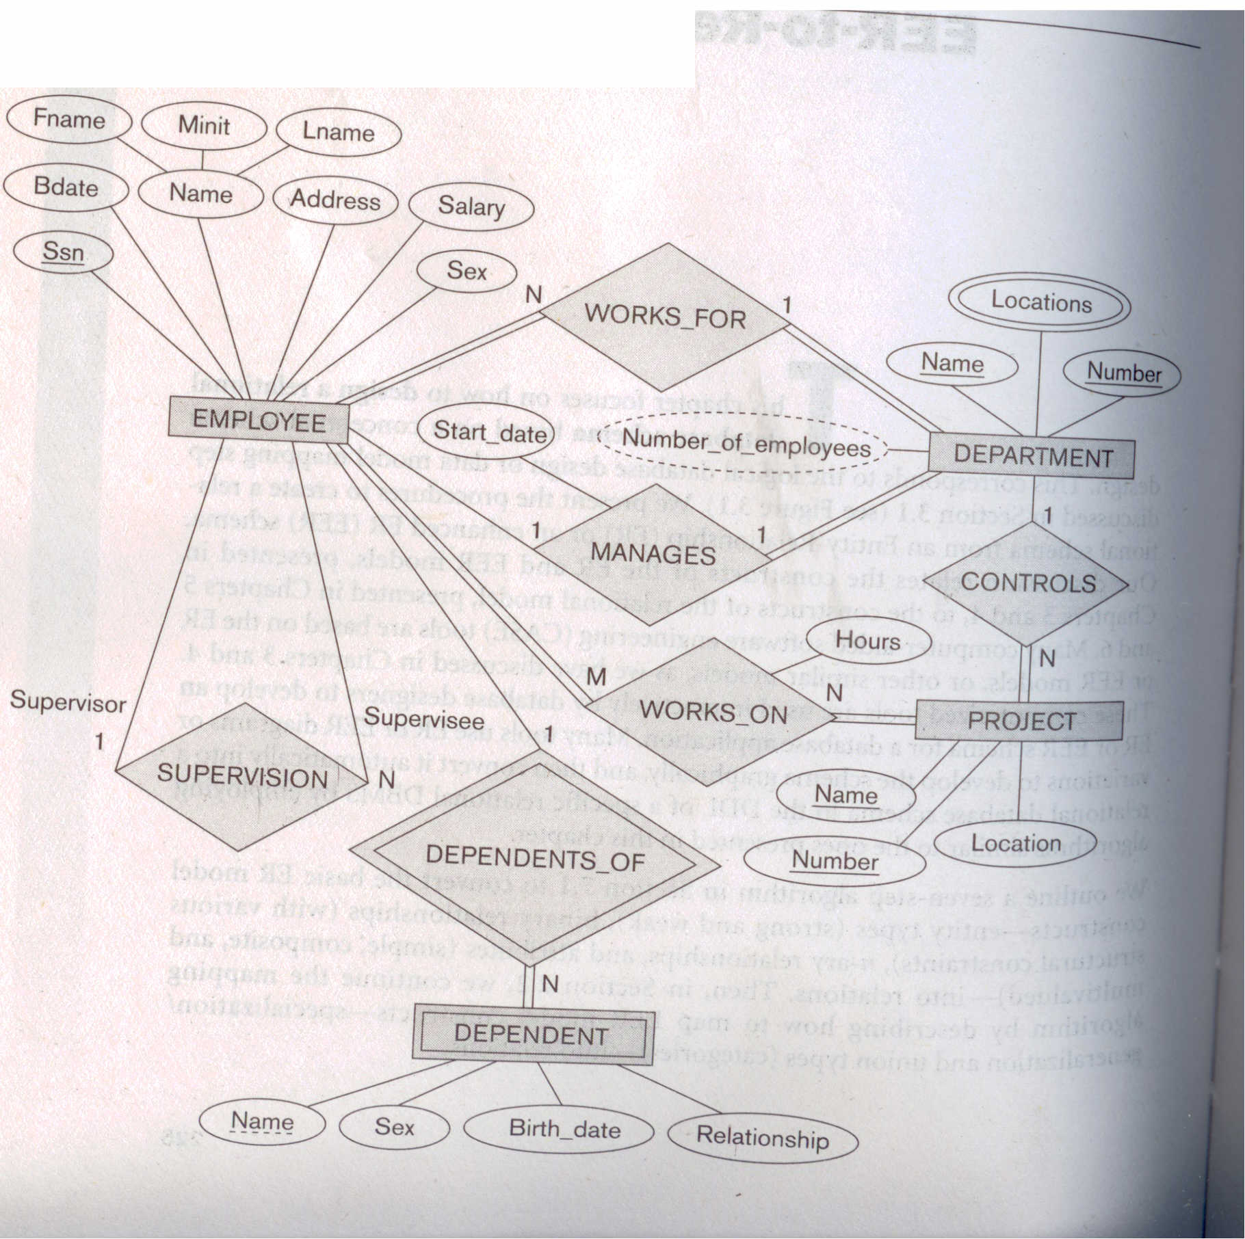

Slide 69
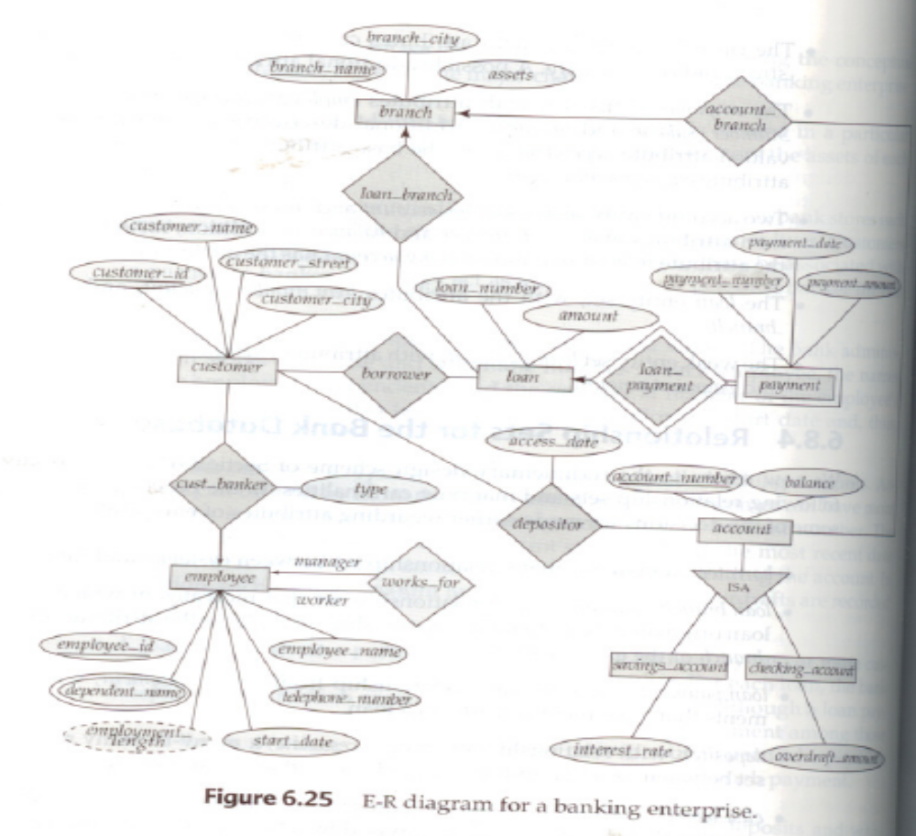

Slide 70


Slide 72
SQL
Structured Query Language

Slide 73
SQL is a Standard
SQL is an ANSI (American National Standards Institute) standard computer language for accessing and manipulating database systems. SQL statements are used to retrieve and update data in a database. SQL works with database programs like MS Access, DB2, Informix, MS SQL Server, Oracle, Sybase, etc.
There are many different versions of the SQL language, but to be in compliance with the ANSI standard, they must support the same major keywords in a similar manner (such as SELECT, UPDATE, DELETE, INSERT, WHERE, and others).
Note: Most of the SQL database programs also have their own proprietary extensions in addition to the SQL standard!

Slide 74
SQL Database Tables
A database most often contains one or more tables. Each table is identified by a name (e.g. "Customers" or "Orders"). Tables contain records (rows) with data.
Below is an example of a table called "Persons":
LastName
FirstName
Address
City
Sharma
Manoj
Streeet 10
Jaipur
Verma
Suresh
Street 30
Jodhpur
Kamal
Kari
Street 20
Sanganer

Slide 75
SQL Queries
With SQL, we can query a database and have a result set returned.
A query like this:
SELECT LastName FROM Persons
Gives a result set like this:
LastName
Hansen
Svendson
Pettersen

Slide 76
SQL Data Manipulation Language (DML)
SQL (Structured Query Language) is a syntax for executing queries. But the SQL language also includes a syntax to update, insert, and delete records.
These query and update commands together form the Data Manipulation Language (DML) part of SQL:
  SELECT - extracts data from a database table
  UPDATE - updates data in a database table
  DELETE - deletes data from a database table
  INSERT INTO - inserts new data into a database table

Slide 77
SQL Data Definition Language (DDL)
The Data Definition Language (DDL) part of SQL permits database tables to be created or deleted. We can also define indexes (keys), specify links between tables, and impose constraints between database tables.
The most important DDL statements in SQL are:
CREATE TABLE - creates a new database table
ALTER TABLE - alters (changes) a database table
DROP TABLE - deletes a database table
CREATE INDEX - creates an index (search key)
DROP INDEX - deletes an index

Slide 78
SQL The SELECT Statement
The SELECT statement is used to select data from a table. The tabular result is stored in a result table (called the result-set).
Syntax
SELECT column_name(s)
FROM table_name

Slide 79
To select the columns named "LastName" and "FirstName", use a SELECT statement like this:
SELECT LastName, FirstName FROM Persons
Persons
LastName
FirstName
Address
City
Ola
Timoteivn 10
Sandnes
Svendson
Tove
Borgvn 23
Sandnes
Pettersen
Kari
Storgt 20
Stavanger
LastName
FirstName
Hansen
Ola
Svendson
Tove
Pettersen
Kari

Slide 80
Select All Columns
To select all columns from the "Persons" table, use a * symbol instead of column names, like this:
SELECT * FROM Persons
LastName
FirstName
Address
City
Sharma
Manoj
Streeet 10
Jaipur
Verma
Suresh
Street 30
Jodhpur
Kamal
Kari
Street 20
Sanganer

Slide 81
The SELECT DISTINCT Statement
The DISTINCT keyword is used to return only distinct (different) values.
The SELECT statement returns information from table columns. But what if we only want to select distinct elements?
With SQL, all we need to do is to add a DISTINCT keyword to the SELECT statement:
Syntax
SELECT DISTINCT column_name(s)
FROM table_name

Slide 82
Using the DISTINCT keyword
To select ALL values from the column named "Company" we use a SELECT statement like this:
SELECT Company FROM Orders
Orders
Company
Company
OrderNumber
Sega
Sega
3412
omega
omega
2312
Trio
Trio
4678
omega
omega
6798

Slide 83
Note that "W3Schools" is listed twice in the result-set.
To select only DIFFERENT values from the column named "Company" we use a SELECT DISTINCT statement like this:
SELECT DISTINCT Company FROM Orders
Orders
Company
Sega
Company
OrderNumber
W3Schools
Sega
3412
Trio
W3Schools
2312
Trio
4678
W3Schools
6798

Slide 84
Select All Columns
The WHERE clause is used to specify a selection criterion.
The WHERE Clause
To conditionally select data from a table, a WHERE clause can be added to the SELECT statement.
Syntax
SELECT column FROM table
WHERE column operator value

Slide 85
With the WHERE clause, the following operators can be used:
Operator
Description
=
Equal
<>
Not equal
>
Greater than
<
Less than
>=
Greater than or equal
<=
Less than or equal
BETWEEN
Between an inclusive range
LIKE
Search for a pattern
Note: In some versions of SQL the <> operator may be written as !=

Slide 86
Using the WHERE Clause
To select only the persons living in the city "Sandnes", we add a WHERE clause to the SELECT statement:
SELECT * FROM Persons
WHERE City='Sandnes'
LastName
FirstName
Address
City
Year
Hansen
Allen
Timoteivn 10
Jaipur
1951
Svendson
Tove
Borgvn 23
jaipur
1978
Svendson
Stale
Kaivn 18
Jaipur
1980
Pettersen
Kari
Storgt 20
Stavanger
1960
LastName
FirstName
Address
City
Year
Hansen
Allen
Timoteivn 10
Jaipur
1951
Svendson
Tove
Borgvn 23
Jaipur
1978
Svendson
Stale
Kaivn 18
Jaipur
1980

Slide 87
Using Quotes
Note - we have used single quotes around the conditional values in the examples.
SQL uses single quotes around text values (most database systems also accept double quotes).
Numeric values should not be enclosed in quotes.
For text values:
This is correct:
SELECT * FROM Persons WHERE FirstName='Tove'
This is wrong:
SELECT * FROM Persons WHERE FirstName=Tove

Slide 88
The LIKE Condition
The LIKE condition is used to specify a search for a pattern in a column.
Syntax
SELECT column FROM table
WHERE column LIKE pattern
A "%" sign can be used to define wildcards (missing letters in the pattern) both before and after the pattern.

Slide 89
Using LIKE
The following SQL statement will return persons with first names that start with an ‘P':
SELECT * FROM Persons
WHERE FirstName LIKE ‘P%'
The following SQL statement will return persons with first names that end with an 'a':
SELECT * FROM Persons
WHERE FirstName LIKE '%a'

Slide 90
Using LIKE 2
The following SQL statement will return persons with first names that contain the pattern ‘bh':
SELECT * FROM Persons
WHERE FirstName LIKE '%bh%'

Slide 91
SQL The INSERT INTO Statement

Slide 92
The INSERT INTO Statement
The INSERT INTO statement is used to insert new rows into a table.
Syntax
INSERT INTO table_name
VALUES (value1, value2,....)
You can also specify the columns for which you want to insert data:
INSERT INTO table_name (column1, column2,...)
VALUES (value1, value2,....)

Slide 93
Insert a New Row
LastName
FirstName
Address
City
Hensen
Allen
MI ROAD
Jaipur
And this SQL statement:
INSERT INTO Persons
VALUES ('Hetland', 'Camilla', 'Hagabakka 24', 'Sandnes')
LastName
FirstName
Address
City
Hensen
Allen
MI Road
Jaipur
Date
CJ
Civil lines
Jaipur

Slide 94
The Update Statement
The UPDATE statement is used to modify the data in a table.
Syntax
UPDATE table_name
SET column_name = new_value
WHERE column_name = some_value

Slide 95
Update one Column in a Row
LastName
FirstName
Address
City
Nilsen
Fred
Kirkegt 56
Sanganer
Ramaswami
Storgt 67
We want to add a first name to the person with a last name of "Ramaswami":
UPDATE Person SET FirstName = 'Nina'
WHERE LastName = 'Ramaswami'
LastName
FirstName
Address
City
Nilsen
Fred
Kirkegt 56
Sanganer
Ramaswami
Nina
Storgt 67

Slide 96
Update several Columns in a Row
LastName
FirstName
Address
City
Nilsen
Fred
Kirkegt 56
Stavanger
Ramaswami
Storgt 67
We want to change the address and add the name of the city:
UPDATE Person
SET Address = 'Stien 12', City = 'Stavanger'
WHERE LastName = 'Ramaswami
'
LastName
FirstName
Address
City
Nilsen
Fred
Kirkegt 56
Stavanger
Ramaswami
Nina
Stien 12
Stavanger

Slide 97
The Delete Statement
The DELETE statement is used to delete rows in a table.
Syntax
DELETE FROM table_name
WHERE column_name = some_value

Slide 98
Delete a Row
LastName
FirstName
Address
City
Hensen
Allen
MI Road
Jaipur
Date
CJ
Civil lines
Jaipur
“CJ Date" is going to be deleted:
DELETE FROM Person WHERE LastName = ‘Date'
LastName
FirstName
Address
City
Hensen
Allen
MI Road
Jaipur

Slide 99
Delete All Rows
It is possible to delete all rows in a table without deleting the table. This means that the table structure, attributes, and indexes will be intact:
DELETE FROM table_name
Or
DELETE * FROM table_name

Slide 100
SQL- Data Definition Language

Slide 101
DDL
Introduction
Data Definition Language
  Create
  Drop
  Truncate
  Alter
  ADD

Slide 102
Section I
Data Definition Language
Introduction

Slide 103
DDL
Creating a Database
Syntax:
  CREATE DATABASE database_name

Slide 104
DDL
Creating a Table
Syntax
  CREATE TABLE table_name
  (Column_name datatype[(size)],
  Column_name datatype[(size)],
  )
Example
  CREATE TABLE books
  (ISBN char(20),
  Title char(50),
  AuthorID Integer,
  Price float)
Creates a table with four columns

Slide 105
DDL
Data Types
Following broad categories of data types exist in most databases:
  String Data
  Numeric Data
  Temporal Data
  Large Objects

Slide 106
DDL
String Data
Fixed Length:
Occupies the same length of space in memory no matter how much data is stored in them.
Syntax:
  char(n) where n is the length of the String
  e.g. name char(50)
If the variable stored for name is ‘CJDate’ the extra 44 fields are padded with blanks

Slide 107
DDL
String Data
Variable Length string is specified with maximum length of characters possible in the string, however, the allocation is sized to the size of the data stored in memory.
Syntax:
  Varchar(n) – n is the maximum length of data possible for the type
There may be a restriction in the maximum length of the data that you can specify in the declaration which will vary according to the database.
All character data has to be enclosed in single quotes during specification.

Slide 108
DDL
Numeric Data Types
Store all the data related to purely numeric data.
Some numeric data may also be stored as a character field e.g. zip codes
Common Numeric Types:
  Decimal Floating point number
  Float Floating point number
  Integer(size) Integer of specified length
  Number A standard number field that can hold a floating point data
Note: Different databases name their numeric fields differently and may not support all numeric types. They may also support additional numeric types.

Slide 109
DDL
Temporal Data Types
These represent the dates and time:
Three basic types are supported:
  Dates
  Times
  Date-Time Combinations

Slide 110
DDL
Large Data Objects
These are used for storing data objects like files and images:
There are two types:
  Character Large Objects (clobs)
  Binary Large Objects (blobs)

Slide 111
Specifying Keys- Introduction
  Unique - This ensures that duplicate rows are not created in the database.
Both Primary keys and Candidate Keys can be specified in the database.
Once a set of columns has been declared unique, any data entered that duplicates the data in these columns is rejected.
Specifying a single column as unique:
Example
  CREATE TABLE Studios
  (studio_id Number,
  name char(20),
  city varchar(50),
  state char(2),
  UNIQUE (name))
Here the name attribute is a candidate key

Slide 112
Specifying Keys- Multiple Columns
Specifying multiple columns as unique:
Example:
  CREATE TABLE Studios
  (studio_id Number,
  name char(20),
  city varchar(50),
  state char(2),
  UNIQUE (name),
  UNIQUE(city, state))
Here both name & city/state combination are unique.

Slide 113
Specifying Keys- Primary Key
Specifying multiple columns as unique:
To specify the Primary Key the Primary Key clause is used
Example:
CREATE TABLE Studios
(studio_id Number,
name char(20),
city varchar(50),
state char(2),
PRIMARY KEY (studio_id),
UNIQUE (name),
UNIQUE(city, state)
)

Slide 114
DDL
Specifying Keys- Single and MultiColumn Keys
Single column keys can be defined at the column level instead of at the table level at the end of the field descriptions.
MultiColumn keys still need to be defined separately at the table level
CREATE TABLE Studios
(studio_id Number PRIMARY KEY,
name char(20) UNIQUE,
city varchar(50),
state char(2),
Unique(city, state))
Note: Some databases require the use of Unique Index for specification of keys.

Slide 115
DDL
Specifying Keys- Foreign Keys
References clause is used to create a relationship between a set of columns in one table and a candidate key in the table that is being referenced.
Example:
CREATE TABLE Movies
(movie_title varchar(40),
studio_id Number REFERENCES Studios(studio_id))
Creates a relationship from the Movies table to the Studios table

Slide 116
DDL
Constraints- Disallowing Null Values
Disallowing Null Values:
  Null values entered into a column means that the data in not known.
  These can cause problems in Querying the database.
  Specifying Primary Key automatically prevents null being entered in columns which specify the primary key
Not Null clause is used in preventing null values from being entered in a column.
Example:
CREATE TABLE Studios
( studio_id number PRIMARY KEY,
name char(20) NOT NULL,
city varchar(50) NOT NULL,
state char(2) NOT NULL)
Null clause can be used to explicitly allow null values in a column also

Slide 117
DDL
Constraints- Value Constraints
Value Constraints:
  Allows value inserted in the column to be checked condition in the column constraint.
Check clause is used to create a constraint in SQL
Example:
CREATE TABLE Movies
(movie_title varchar(40) PRIMARY KEY,
studio_id Number,
budget Number check (budget > 50000)
)
Table level constraints can also be defined using the Constraint keyword
Example:
CREATE TABLE Movies
(movie_title varchar(40) PRIMARY KEY,
studio_id Number,
budget Number check (budget > 50000),
release_date Date,
CONSTRAINT release_date_constraint Check (release_date between ’01-Jan-1980’ and ’31-dec-1989))
Such constraints can be activated and deactivated as required.

